Slide 1
Теория Информации
В.Н. Ярмолик
Лекция 18
2017

Slide 2
Digital Signature
Hash functions
Hash function H(M) has the message M to be encrypted as argument. The length of the message have to be an arbitrary, as well as the size of the hash function is fixed by m bits. It is important to emphasize that function H(M) is one way function, it means that recovering of plaintext based on the value of the function is impossible.
Most hash functions is calculated based on the following recurrence relation
H_{i}=H(M_{i},H_{i-1})
M _{i}
H _{i}
H
H _{i-1}
where M_{i} is consecutive block of the message.
For the case, when the length of hash value Hi and message block are equal, then the following diagram for calculation can be applied.

Slide 3
Digital Signature
Hash functions
For the case, when the length of hash value H_{i} and message block are equal, then the following diagram for calculation can be applied.
A
C
Key
H
Cipher
B
H₀-IV – Initial Vector; H_{i}=E_{A}(B)⊕C, where A, B, and C can take the following meaning M_{i}, H_{i-1} and (M_{i}⊕H_{i-1}) or be a constant values. where M_{i} is consecutive block of the message.

Slide 4
Digital Signature
Hash functions
There are 64 possible implementation of the Hash function according to the last block diagram. Some of them are shown below.
1 | H_{i} = E_{Hi-1} (M_{i}) ⊕ M_{i}
2 | H_{i} = E_{Hi-1} (M_{i} ⊕ H_{i-1}) ⊕ M_{i} ⊕ H_{i-1}
3 | H_{i} = E_{Hi-1}(M_{i}) ⊕ H_{i-1} ⊕ M_{i}
4 | H_{i} = E_{Hi-1} (M_{i} ⊕ H_{i-1}) ⊕ M_{i}
5 | H_{i} = E_{Mi} (H_{i-1}) ⊕ H_{i-1}
6 | H_{i} = E_{Mi} (M_{i} ⊕ H_{i-1}) M_{i} ⊕ H_{i-1}
7 | H_{i} = E_{Mi} (H_{i-1}) M_{i} ⊕ H_{i-1}
8 | H_{i} = E_{Mi} (M_{i} ⊕ H_{i-1}) ⊕ H_{i-1}
9 | H_{i} = E_{Mi⊕Hi-1}(M_{i}) ⊕ M_{i}
10 | H_{i} = E_{Mi⊕Hi-1} (H_{i-1}) ⊕ H_{i-1}
11 | H_{i} = E_{Mi⊕Hi-1} (M_{i}) ⊕ H_{i-1}
12 | H_{i} = E_{Mi⊕Hi-1} (H_{i-1}) ⊕ M_{i}

Slide 5
Digital Signature
Hash functions
The most often used hash functions.
H_{i-1}
H_{i-1}
Key
Key
M_{i}
H_{i}
M_{i}
H_{i}
Cipher
Cipher
(1)
(2)
H_{i-1}
H_{i-1}
Key
Key
M_{i}
H_{i}
M_{i}
H_{i}
Cipher
Cipher
(3)
(4)

Slide 6
Digital Signature
Hash functions SHA
Secure Hash Algorithm (SHA) have been developed within the framework of developing Secure Hash Standard in 1992. This secure hash algorithm is an integral part of the Digital Signature Algorithm (DSA).
The size of the message M to be encrypted have to be less then 2⁶⁴.
Hash function H(M) is called Message Digest (MD) and has the size m=160 bits.
Determination of the H(M) according to the Secure Hash Algorithm has the following steps:
1. The message M is divided into the blocks M_{i} with the standard size – 512 bits.
2. The five 32 bits variable takes their initial value.
A=0X67452301
B=0XEFCDAB89
C=0X98BADCFE
D=0X10325476
E=0XC3D2E1F0
M
M₁
M₂
…
M_{j-1}
1000…
M_{j}
512
512
512
512
The 64 bits code of the message length

Slide 7
Digital Signature
Hash functions SHA
3. The main cycle is calculated to perform 512 bit block M_{i}, starting from M₁, then M₂, …, and up to M_{j} . For each block M_{i} the standard procedure have to be performed. The five 32 bit variable A, B, C, D and E are copied into internal variable a, b, c, d, and e. The main cycle can be described as:
For t=0 to 79
TEMP=(a<<<5)⊕f_{t}(b,c,d)⊕e⊕W_{t}⊕K_{t}
e=d
d=c
c=(b<<<30)
a=TEMP

Slide 8
Digital Signature
Hash functions SHA
W_{t}
K_{t}
e_{t-1}
e_{t}
d_{t-1}
d_{t}
c_{t-1}
f_{t}
c_{t}
b_{t-1}
b_{t}
<<< 30
a_{t-1}
<<< 5
a_{t}

Slide 9
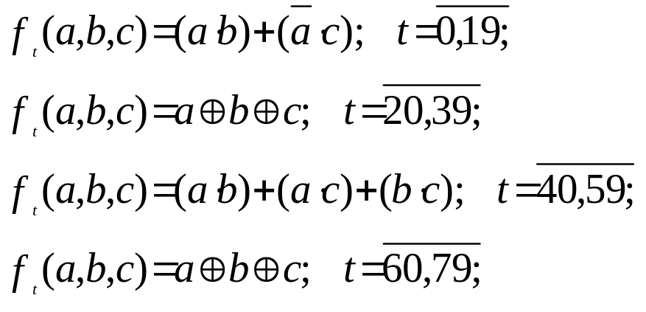
Digital Signature
Hash functions SHA
Nonlinear Boolean functions f_{t}(a,b,c) are:
There are four constant values K_{t}=0X5A827999, K_{t}=0X6ED9EBA1, K_{t}=0X8F1BBCDC, K_{t}=0XCA62C1D6 for the same values of t as in a case of Boolean functions.

Slide 10
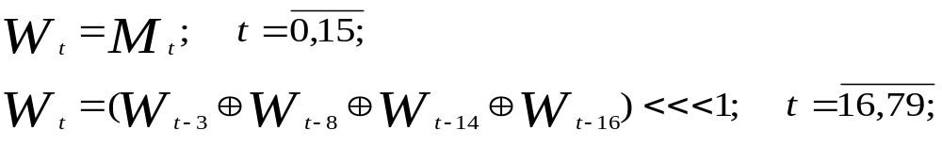
Digital Signature
Hash functions SHA
Block M_{i} consisting from sixteen 32 bit word (M₀, M₁, …, M₁₅) are converted into eighty 32-bit words (W₀,W₁,…,W₇₉), according to the relations
where <<<s, is a cyclic shift to the left on s positions.
4. At the end of main cycle the values of variables a, b, c, d, and e are added to the values of corresponding variables A, B, C, D, and E.
The final values is generated as a concatenation of variables A, B, C, D, and E.

